Slide 1

sds
Customer Personality Analysis
TEAM MEMBERS :
1)AMULYA : HU21CSEN0500091
2)VENNELA : HU21CSEN0500096
3)TANISHKA : HU21CSEN0500097
4)VAISHNAVI : HU21CSEN0500169
.

Slide 2
INTRODUCTION
Customer Personality Analysis is a detailed analysis of all types of customers in a company.
It also helps a business to understand customer behavior, increase usage and customer
satisfaction and Modify products according to their needs. We are targeting specific people
who paved the way for increasing marketing campaigns. These Personality-based analyses are
highly effective in increasing the popularity and attractiveness of products and services.
UNDERSTANDING THE DATA
Customer personality analysis helps a business modify its product based on its target
customers from different types of customer segments. For example, Instead of spending money
to market a new product to every customer in the company's database, a company can analyses
which customer segment is most likely to buy the product and then market the product only on
that particular segment.

Slide 3
ABSTRACT:
Explore 'Customer Personality Analysis: Understanding Your Customers with Data Science in Python.' This project navigates the realm of data science, utilizing Python to dissect customer data. From meticulous data preprocessing to insightful exploratory data analysis (EDA) and the application of machine learning algorithms, the project unveils patterns in customer behavior. Additionally, it introduces sentiment analysis for deeper insights and customer segmentation for targeted strategies. With practical implementation and code examples, this guide empowers businesses to make informed decisions, enhance customer satisfaction, and foster growth through a nuanced understanding of their customer base."

Slide 4


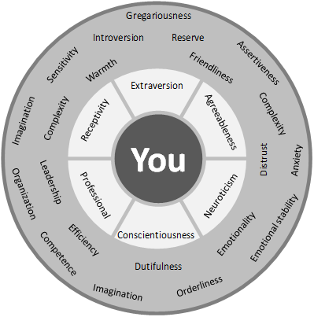
What is Customer Personality Analysis?
1
Definition
Customer Personality Analysis is the process of analyzing customer data to better understand their preferences, behaviours, and concerns.
2
Data Sources
Companies can gather data from multiple sources, such as social media, online interactions, and purchase history.
3
Benefits
Customer Personality Analysis helps businesses to tailor their products and services to their customers' needs, resulting in increased customer satisfaction and loyalty.

Slide 5

Benefits for Businesses
Improved Marketing
Better Customer Service
With a better understanding of their customers, businesses can create targeted marketing campaigns that are more likely to convert leads into customers.
By identifying customer pain points, businesses can provide more personalized customer service and improve overall customer experience.
Increased Retention
By understanding what their customers want, businesses can create products/services that better meet their needs, leading to increased customer retention.

Slide 6
Customer Journey Optimization
Enhanced Customer Experience
Customer insights enable businesses to optimize the customer journey, ensuring seamless and personalized interactions at every touch point.
Conversion Rate Optimization
By understanding customer behavior, businesses can optimize conversion funnels
and Processes to drive higher conversion rates and sales.
Retention Strategies
Customer insights inform the development of retention strategies focusing on Nurturing long-term customer relationships and loyalty.

Slide 7
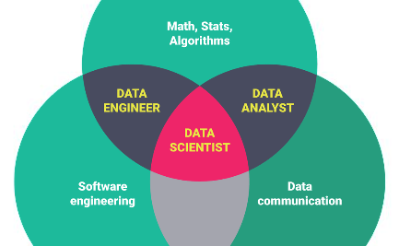
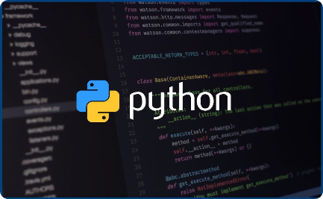
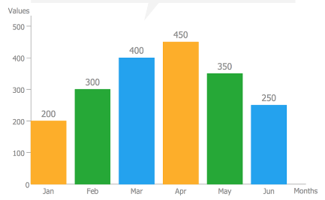
Data Science Project Overview
Goal
Tools Required
Data Visualization
The goal of this project is to analyze customer data and identify customer personas for a hypothetical company analyze.
Python, Pandas, Numpy, Seaborn, Matplotlib
We'll use various graphs and charts to visualize customer data and identify patterns and trends.

Slide 8
Methodology
1
Data Collection & Preparation
Gather data from various internal and external sources and clean and organise data for analysis purposes.
Exploratory Data Analysis
2
Apply statistical techniques to explore the data and identify patterns, correlations, and relationships between different features.
3
Feature Selection & Creation
Select and create features that are most predictive of customer behavior and preferences.
Model Selection & Validation
4
Use machine learning algorithms to cluster customers into different personas, and validate the accuracy of the model.

Slide 9
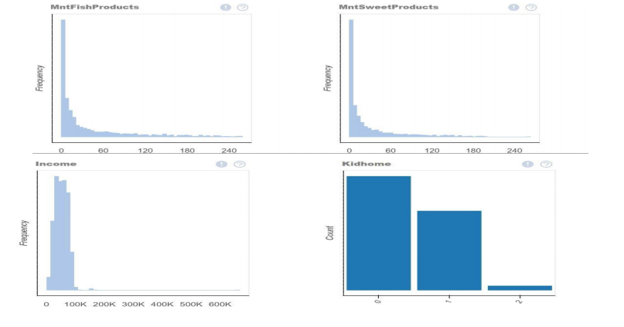
EXPLORATORY DATA ANALYSIS:-

Slide 10
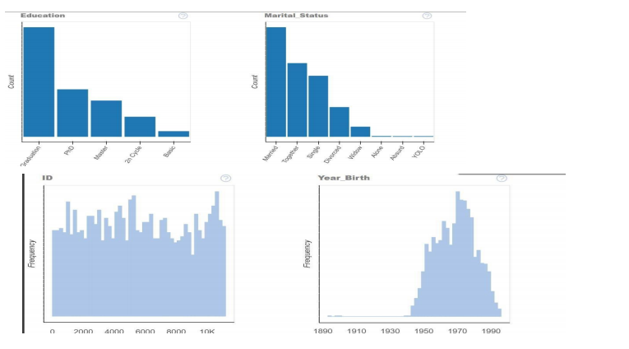

Slide 11
Maximizing Customer Relationships
Understanding Individual Preferences:
Analyzing customer data to understand individual preferences, behaviors, and needs Utilizing customer segmentation to tailor interactions based on specific characteristics or preferences.
Emotional Connection:
Personalized communication builds emotional connections with customers, driving brand affinity and long-term loyalty.
Feedback and Engagement
Leveraging customer analysis to encourage feedback and engagement, nurturing a customer centrist approach to business.

Slide 12

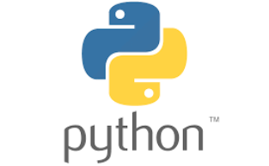

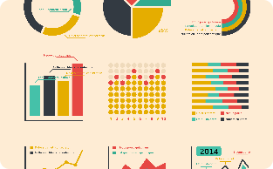
Tools Required
Computer
Python
Pandas
Data Visualization
A computer is required to run the Python scripts and store data.
Python is a programming language used for data analysis and machine learning.
Pandas is a Python library used for data manipulation and analysis.
Matplotlib and Seaborn are Python libraries used to visualize data.

Slide 13
Conclusion
1
Customer Understanding
2
Data Science Applications
Customer Personality Analysis can help businesses better understand their customers and create more personalized products and services.
Data science techniques can be effectively used to capture, process and analyze customer data to facilitate customer personality analysis.
3
Business Benefits
Businesses can achieve many benefits from customer personality analysis and gain a competitive advantage in today's market.

Slide 14
REFERENCES:-
[1] Ramadhanti, A. R., Bastikarana, R. S., Alamsyah, A., & Widiyanesti, S. (2020). Determining customer relationship management strategy with customer personality analysis using ontology model approach. Jurnal Manajemen Indonesia, 20(2), 83-94.
[2] Regulagadda, R., Pankajam, A., Rahman, S. Z., Prasad, D. R., Chapala, H. K., Nagarjuna, V., & Gupta, A. (2024). Customer Personality Analysis using Segments and Exploratory Data Analysis. International Journal of Intelligent Systems and Applications in Engineering, 12(4s), 794-800.
[3] Chun, W. (2001). Core python programming (Vol. 1). Prentice Hall Professional.
[4] Rolon-Mérette, D., Ross, M., Rolon-Mérette, T., & Church, K. (2016). Introduction to Anaconda and Python: Installation and setup. Quant. Methods Psychol, 16(5), S3-S11.

Slide 15
THANK YOU

